Slide 1
ENGINEERING ECONOMY
LECTURE 1
PROF.DR. YASEMİN ASU ÇIRPICI, MU, DEPT. OF ECONOMICS

Slide 2
Engineering Economy:
Engineering Economy is A collection of mathematical techniques that simplify economic comparison and assist people in making decisions.
Fundamentally, engineering economy involves formulating, estimating and evaluating the economic outcomes when alternatives to accomplish a defined purpose are available.
The need for engineering economy is primarily motivated by the work that engineers do in performing analyses, synthesizing, and coming to a conclusion as they work on projects of all sizes.
In other words, engineering economy is at the heart of making decisions. These decisions involve the fundamental elements of cash flows of money, time, and interest rates.

Slide 3
Steps in an Engineering Economy Study
The steps in an engineering economy study are as follows:
1. Identify and understand the problem; identify the objective of the project.
2. Collect relevant, available data and define viable solution alternatives.
3. Make realistic cash flow estimates.
4. Identify an economic measure of worth criterion for decision making.
5. Evaluate each alternative; consider noneconomic factors; use sensitivity analysis as needed.
6. Select the best alternative.
7. Implement the solution and monitor the results.

Slide 4
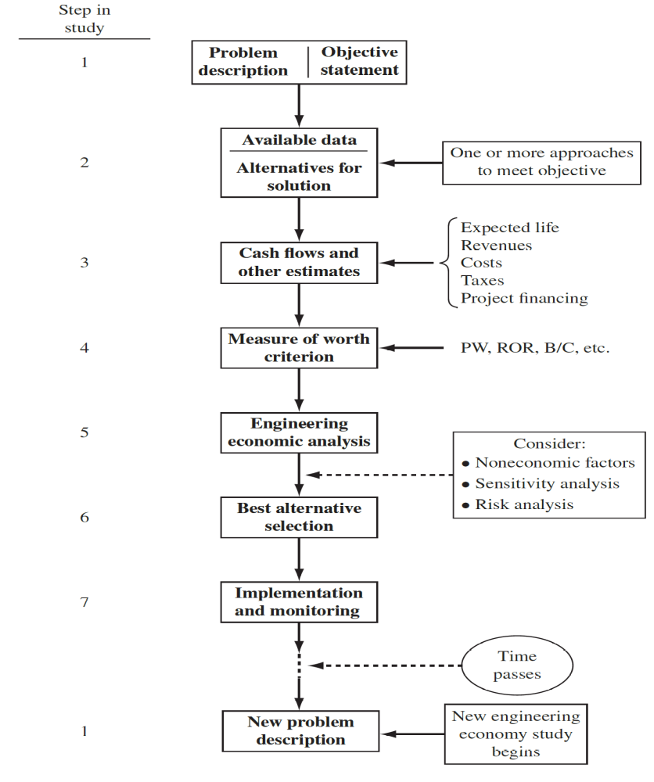

Slide 5
Descriptions of several of the elements in the steps are important to understand.
Problem Description and Objective Statement: A clear, short description of the problem and main goals is essential for finding other possible solutions.
Ex:
Problem Description: A coal-fueled power plant must be shut down by 2025 due to the production of excessive sulfur dioxide.
Objectives: Generate the forecasted electricity needed for 2025 and beyond, plus to not exceed all the projected emission allowances in these future years.

Slide 6
Alternatives: These are stand-alone descriptions of viable solutions to problems that can meet the objectives. Words, pictures, graphs, equipment and service descriptions, simulations, etc. define each alternative. The best estimates for parameters are also part of the alternative.
Some parameters include
equipment first cost,
expected life,
salvage value (estimated trade-in, resale, or market value), and
annual operating cost (AOC), which can also be termed maintenance and operating (M&O) cost, and
subcontract cost for specific services. If changes in income (revenue) may occur, this parameter must be estimated.
Detailing all viable alternatives at this stage is crucial.

Slide 7
Cash Flows: All cash flows are estimated for each alternative.
Since these are future expenditures and revenues, the results of step 3 usually prove to be inaccurate when an alternative is actually in place and operating.
When cash flow estimates for specific parameters are expected to vary significantly from a point estimate made now, risk and sensitivity analyses (step 5) are needed to improve the chances of selecting the best alternative.
Sizable variation is usually expected in estimates of revenues, AOC, salvage values, and subcontractor costs.

Slide 8
Selection of the Best Alternative: The measure of worth is a primary basis for selecting the best economic alternative. For example, if alternative A has a rate of return (ROR) of 15.2% per year and alternative B will result in an ROR of 16.9% per year, B is better economically.
However, there can always be noneconomic or intangible factors that must be considered and that may alter the decision. There are many possible noneconomic factors; some typical ones are:
• Market pressures, such as need for an increased international presence
• Availability of certain resources, e.g., skilled labor force, water, power, tax incentives
• Government laws that dictate safety, environmental, legal, or other aspects
• Corporate management’s or the board of director’s interest in a particular alternative
• Goodwill offered by an alternative toward a group, for example, employees, union, county, etc.

Slide 9
Whether we are aware of it or not, we use criteria every day to choose between alternatives.
For example, when you drive to campus or work, you decide to take the “best” route.
But how did you define best?
Was the best route the safest, shortest, fastest, cheapest, most scenic, or what?
Obviously, depending upon which criterion or combination of criteria is used to identify the best, a different route might be selected each time.
In economic analysis, money (such as dollars or other currency) is usually used as the common measure for evaluating alternatives.
Thus, when there are several ways of accomplishing a stated objective, the alternative with the lowest overall cost or highest overall net income is selected.

Slide 10
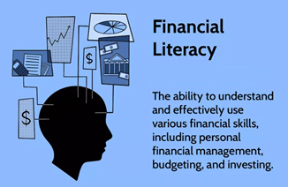
Financial literacy
To be financially literate is very important as an engineer and as a person.
Unfortunately many people do not have the fundamental understanding of concepts such as financial risk and diversification, inflation, numeracy, and compound interest.
Financial literacy is the set of skills needed to handle money wisely, invest effectively, and plan for a comfortable future.
It is the ability to understand and effectively use various financial skills, including personal financial management, budgeting, and investing.

Slide 11
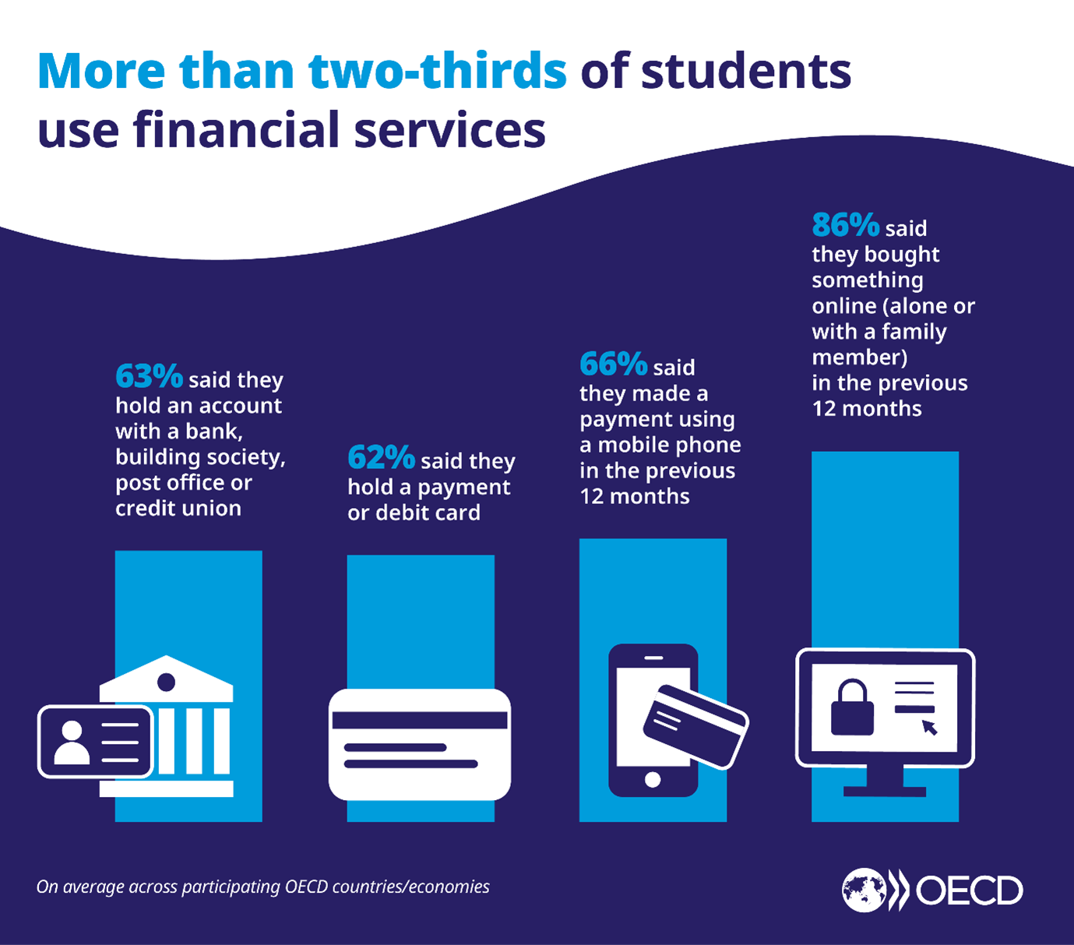
As our latest PISA report on financial literacy shows,
more than two thirds of 15-year-olds are active users of financial products and services.
Over 60% have a bank account and/or a payment card, and
close to 90% have bought something online during the last 12 months.

Slide 12
However, their levels of financial literacy remain low: one-fifth of students, on average, do not have basic proficiency in financial literacy, meaning that they are not able to apply their knowledge to real life situations involving financial issues and decisions.
The fact is many young people simply do not have the knowledge and skills needed to safely navigate the complexities of digital finance.
Policy makers recognize that young people need to be financially literate to perform common tasks in their day-today lives, such as using a payment card, choosing amongst mobile phone plans or understanding the implications of in-app purchases.
Students also need basic financial skills to make important decisions about their future, such as understanding different options for funding their education or choosing between different career and education paths.
As students become increasingly independent from their families, it is likely that the number and complexity of financial decisions will also increase

Slide 13
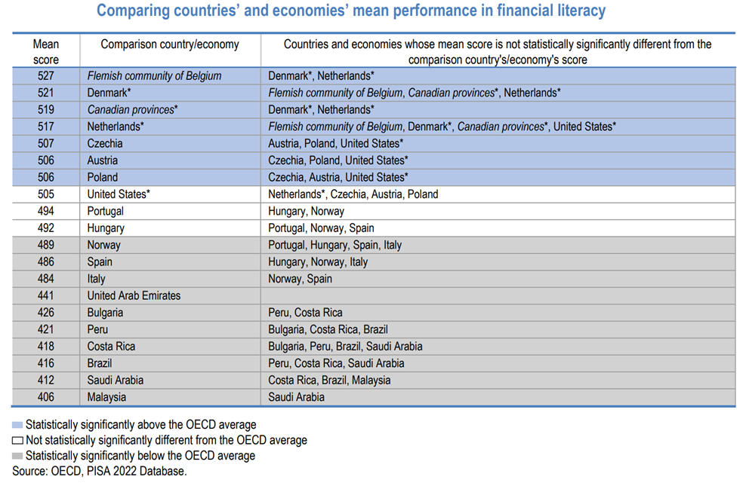

Slide 14
Benefits of Financial Literacy
Broadly speaking, the benefit of financial literacy is that it empowers individuals to make smarter decisions about their finances. In addition:
Financial literacy can prevent devastating financial mistakes: Naive financial decisions can have devastating effects. The payments on a floating-rate loan can rise unexpectedly. An early withdrawal from an IRA will cost you at tax time. Financially literate people don't make these mistakes.
Financial literacy prepares people for financial emergencies: Losing a job or having a major unexpected expense is never easy, but the blow is cushioned for those who have an emergency fund.
Financial literacy can help individuals reach their goals: By understanding how to budget and save money, people define their immediate necessities and focus their minds ahead to important financial goals.
Financial literacy fosters confidence: Imagine having to make a life-changing decision without all the necessary information. With knowledge about finances, individuals can approach major life choices with greater confidence. They'll be more likely to achieve the outcome they desire and less likely to be surprised or hurt by unforeseen outcomes.

Slide 15
What Are Some Popular Personal Budget Rules?
Two commonly used personal budgeting methods are the 50/20/30 and 70/20/10 rules, and their simplicity is what makes them popular.
The first entails dividing your after-tax pay into three areas: needs (50%), savings (20%), and wants (30%).
The 70/20/10 rule follows a similar blueprint, recommending that your after-tax, take-home income be divided into segments devoted to expenses (70%), savings or reducing debt (20%), and investments and charitable donations (10%).

Slide 16
What Are the Principles of Financial Literacy?
There are five broad principles of financial literacy.
financial literacy is to teach individuals about:
earning,
spending,
saving,
borrowing, and
protecting their money.

Slide 17
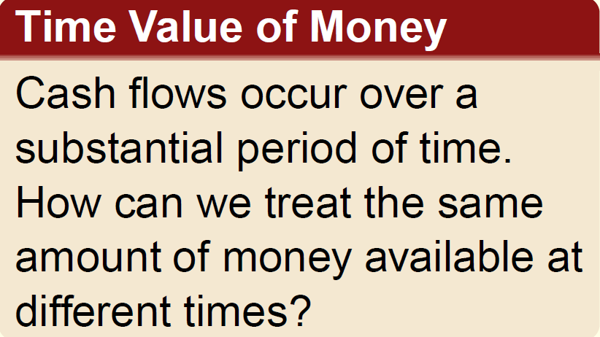
The time value of money
It is a well-known fact that money makes money.
The time value of money explains the change in the amount of money over time for funds that are owned (invested) or owed (borrowed).
In general the time value of money means that a sum of money today is worth more than the same sum in the future, because money today can be invested to earn interest or returns..

Slide 18
If we decide to invest capital (money) in a project today, we inherently expect to have more money in the future than we invested.
If we borrow money today, in one form or another, we expect to return the original amount plus some additional amount of money.
An engineering economic analysis can be performed on future estimated amounts or on past cash flows to determine if a specific measure of worth, e.g., rate of return, was achieved.

Slide 19
EXAMPLE
Which would you rather have?
$100 in your hand right now
A guaranteed $100, but only one year from today

Slide 20
Interest Rate and Rate of Return
Interest refers to the cost of borrowing money or the reward for lending money.
In the financial world, money itself is a commodity, and like other goods that are bought and sold, money costs money.
There are always two perspectives to an amount of interest—interest paid and interest earned.
Interest is paid when a person or organization borrowed money (obtained a loan) and repays a larger amount over time.
Interest is earned when a person or organization saved, invested, or lent money and obtains a return of a larger amount over time.

Slide 21

Interest paid on borrowed funds (a loan) is determined using the original amount, also called the principal,
Interest = amount owed now − principal
When interest paid over a specific time unit is expressed as a percentage of the principal, the result is called the interest rate.
The time unit of the rate is called the interest period.
By far the most common interest period used to state an interest rate is 1 year.
Shorter time periods can be used, such as 1% per month.
Thus, the interest period of the interest rate should always be included. If only the rate is stated, for example, 8.5%, a 1-year interest period is assumed.

Slide 22
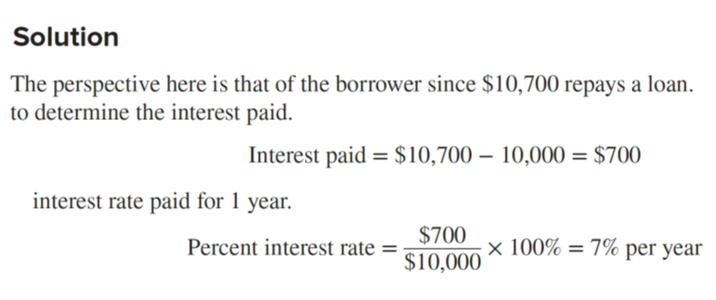
EXAMPLE
An employee at LaserKinetics.com borrows $10,000 on May 1 and must repay a total of $10,700 exactly 1 year later. Determine the interest amount and the interest rate paid.

Slide 23
EXAMPLE
Stereophonics, Inc. plans to borrow $20,000 from a bank for 1 year at 9% interest for new recording equipment.
(a) Compute the interest and the total amount due after 1 year.
(b) Construct a column graph that shows the original loan amount and total amount due after 1 year used to compute the loan interest rate of 9% per year.
Solution
(a) Compute the total interest accrued by solving Equation for interest accrued.
Interest = $20,000(0.09) = $1800
The total amount due is the sum of principal and interest.
Total due = $20,000 + 1800 = $21,800

Slide 24
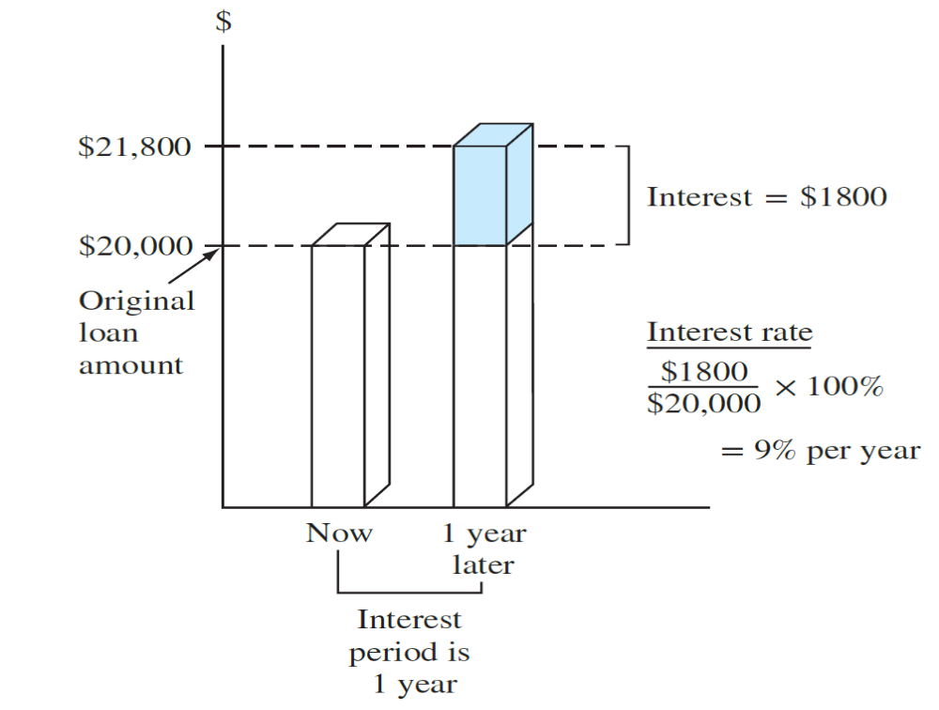
(b) $1800 interest, $20,000 original loan principal, 1-year interest period.
(Note that in part (a), the total amount due may also be computed as
Total due = principal(1 + interest rate) = $20,000(1.09) = $21,800

Slide 25
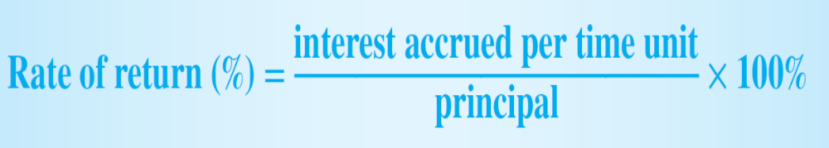
From the perspective of a saver, a lender, or an investor, interest earned is the final amount minus the initial amount, or principal.
Interest earned = total amount now − principal
Interest earned over a specific period of time is expressed as a percentage of the original amount and is called rate of return (ROR).
The time unit for rate of return is called the interest period, just as for the borrower’s perspective. Again, the most common period is 1 year.
The term return on investment (ROI) is used equivalently with ROR in different industries and settings, especially where large capital funds are committed to engineering-oriented programs.
The term interest rate paid is more appropriate for the borrower’s perspective, while the term rate of return earned applies for the investor’s perspective.

Slide 26
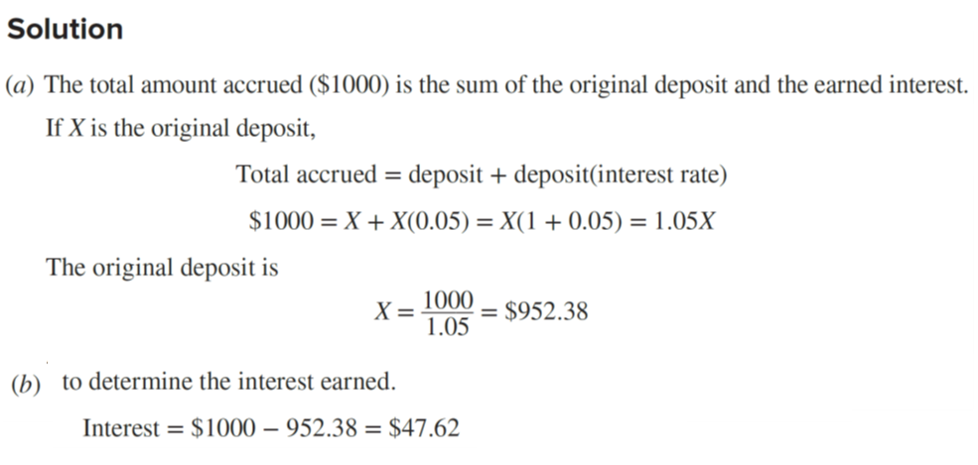
EXAMPLE
(a) Calculate the amount deposited 1 year ago to have $1000 now at an interest rate of 5% per year.
(b) Calculate the amount of interest earned during this time period.

Slide 27
Simple interest and Compound interest
In these examples and the interest amount was calculated at the end of one period.
When more than one interest period is involved, e.g., the amount of interest after 3 years, it is necessary to state whether the interest is accrued on a simple or compound basis from one period to the next.
Simple interest is calculated using the principal only, ignoring any interest accrued in preceding interest periods.
Interest = (Principal)(# of periods)(interest rate)

Slide 28
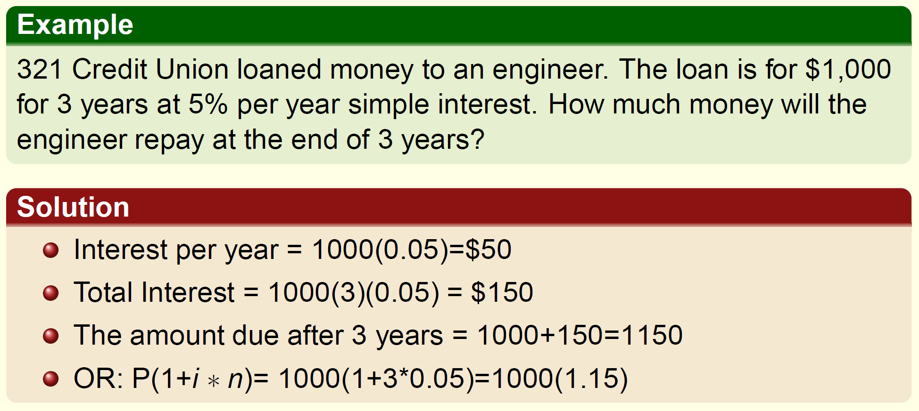

Slide 29
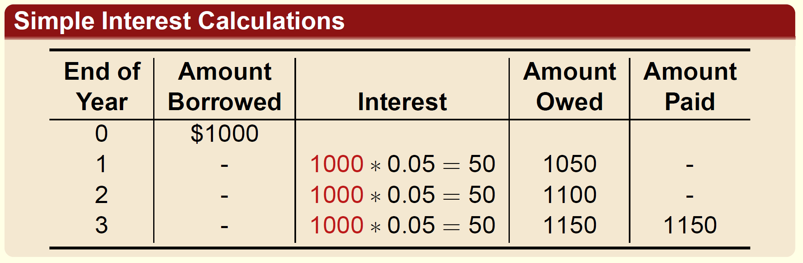

Slide 30
For Compound interest rate, the interest is accrued on the principal plus the total amount of interest accumulated in all previous periods.
Interest = (principal+all accumulated interest)(interest rate)
Therefore, compound interest means interest on top of interest (interest earned earns interest)

Slide 31
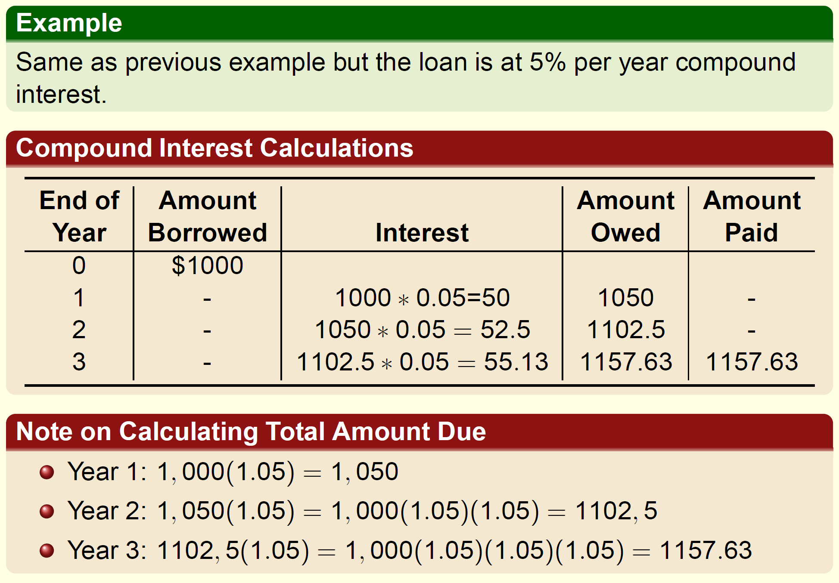

Slide 32
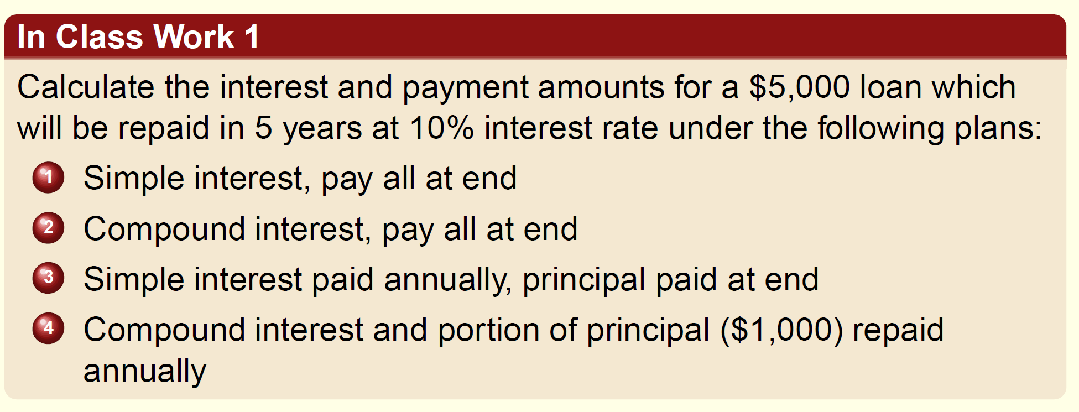
Therefore, in general the formula form:
Total due= Principal (1 + interest rate) ^{number of years}

Slide 33
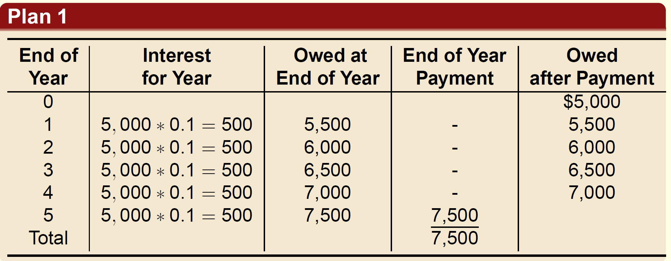
1) Simple interest, pay all at end

Slide 34
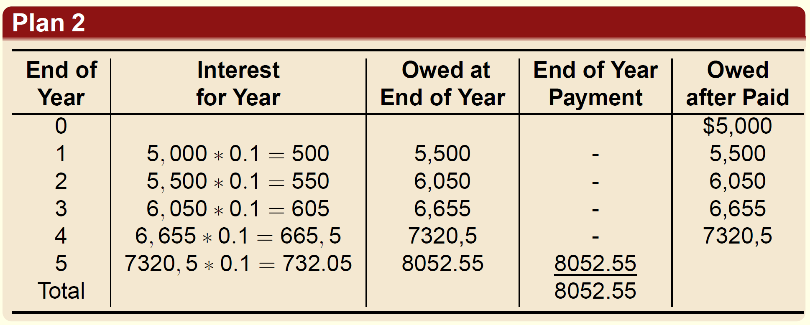
2) Compound interest, pay all at end

Slide 35
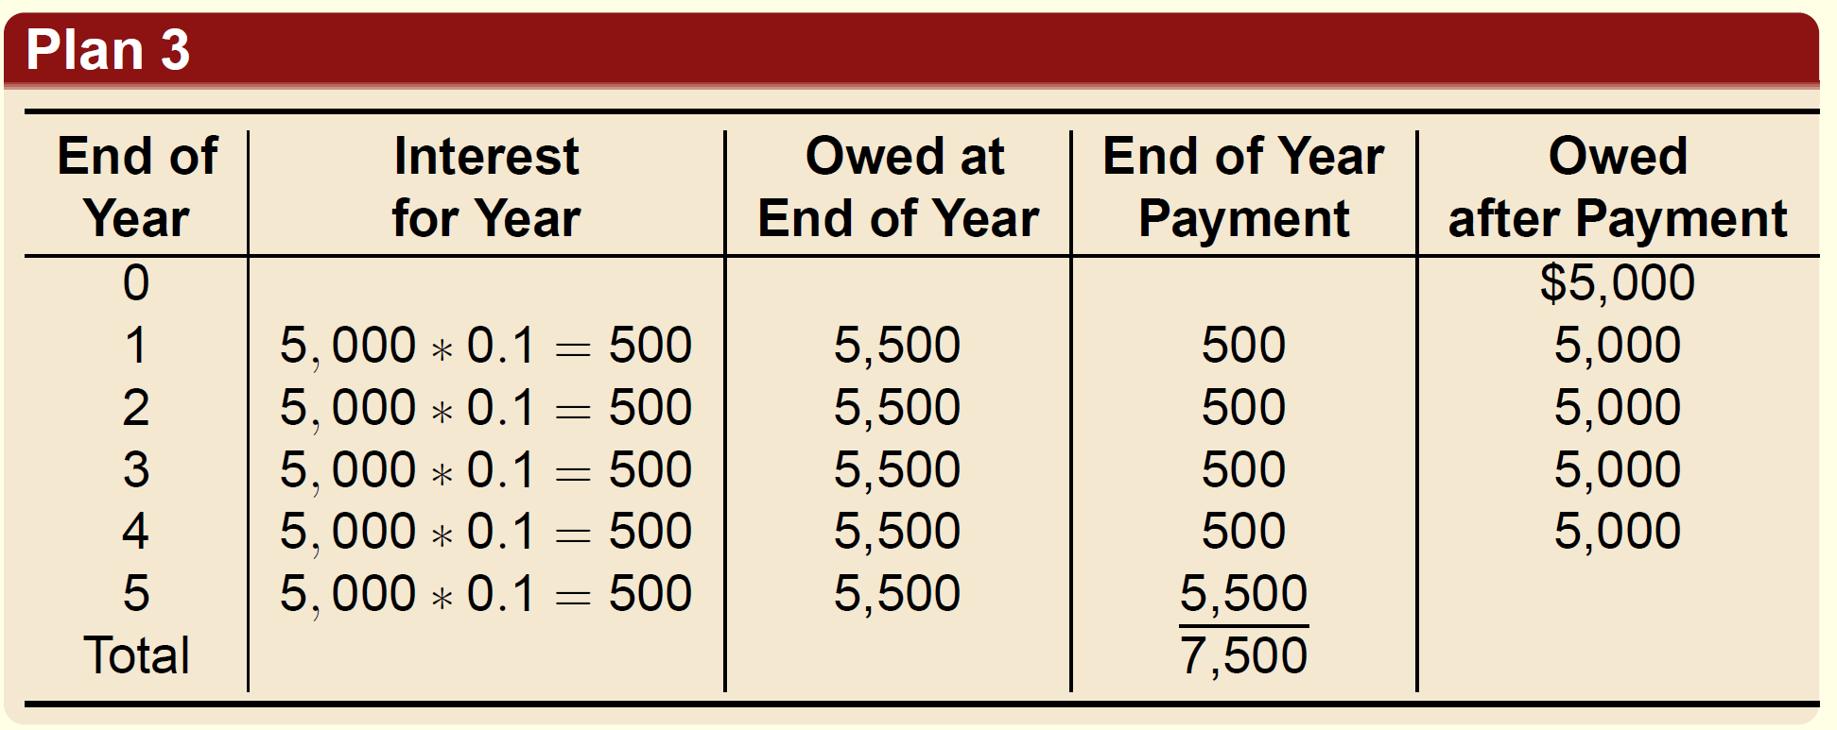
3) Simple interest paid annually, principal paid at end

Slide 36
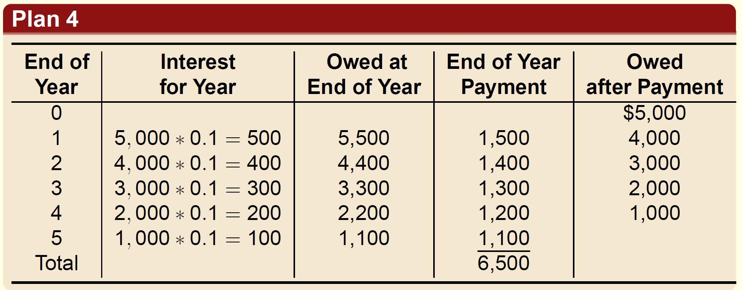
4) Compound interest and portion of principal ($1,000) repaid annually

Slide 37
Terminology and Symbols
P: value or amount of money at present or time 0.
Present Worth (PW)
Present Value (PV)
Net Present Value (NPV)
F: value or amount of money at some future time.
Future Worth (FW)
Future Value (FV)
A: series of consecutive, equal, end-of-period amounts of money.
n: number of interest periods
i: interest rate or rate of return per time period
compound unless otherwise stated
expressed as percent per interest period
t: time stated in periods

Slide 38
EXAMPLE
Today, Julie borrowed $5000 to purchase furniture for her new house. She can repay the loan in either of the two ways described below. Determine the engineering economy symbols and their value for each option.
(a) Five equal annual installments with interest determined at 5% per year.
(b) One payment 3 years from now with interest determined at 7% per year.
Solution
(a) The repayment schedule requires an equivalent annual amount A, which is unknown.
P = $5000 i = 5% per year n = 5 years A = ?
(b) Repayment requires a single future amount F, which is unknown.
P = $5000 i = 7% per year n = 3 years F = ?

Slide 39
EXAMPLE
You plan to make a lump-sum deposit of $5000 now into an investment account that pays 6% per year, and you plan to withdraw an equal end-of-year amount of $1000 for 5 years, starting next year. At the end of the sixth year, you plan to close your account by withdrawing the remaining money. Define the engineering economy symbols involved.
Solution
All five symbols are present, but the future value in year 6 is the unknown.
P = $5000
A = $1000 per year for 5 years
F = ? at end of year 6
i = 6% per year
n = 5 years for the A series and 6 for the F value

Slide 40
EXAMPLE
Last year Jane’s grandmother offered to put enough money into a savings account to generate $5000 in interest this year to help pay Jane’s expenses at college.
(a) Identify the symbols, and
(b) calculate the amount that had to be deposited exactly 1 year ago to earn $5000 in interest now, if the rate of return is 6% per year.
Solution
(a) Symbols P (last year is −1) and F (this year) are needed.
P = ?
i = 6% per year
n = 1 year
F = P + interest = ? + $5000

Slide 41
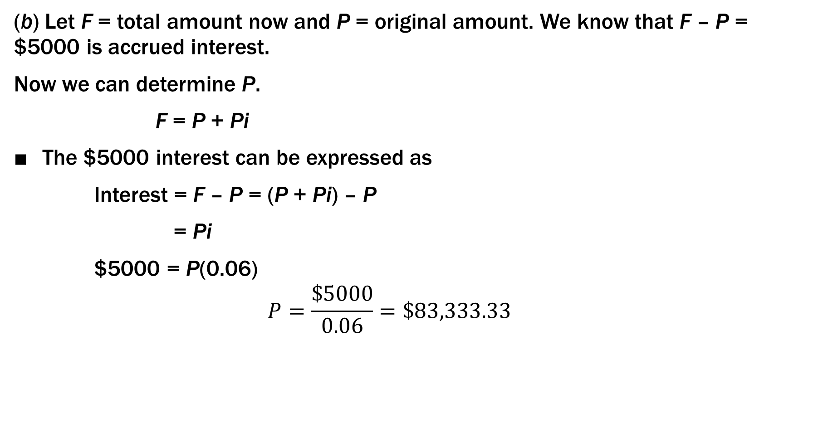
(b) Let F = total amount now and P = original amount. We know that F – P = $5000 is accrued interest.
Now we can determine P.
F = P + Pi
The $5000 interest can be expressed as
Interest = F – P = (P + Pi) – P
= Pi
$5000 = P(0.06)
$$P=\frac{\$5000}{0.06}=\$83,333.33$$

